Slide 1

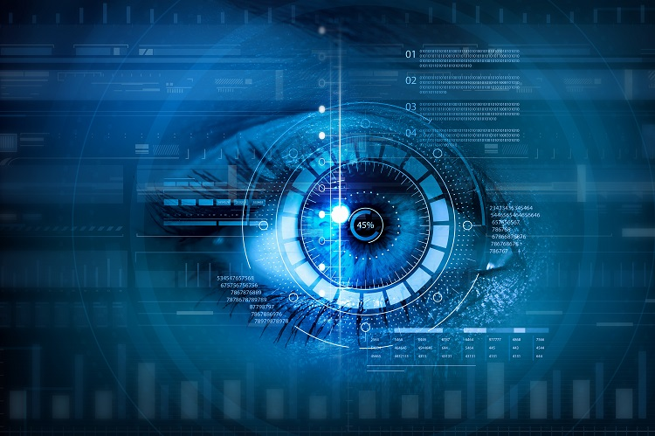
Image processing: feature tracking Lecture 6 by Anna Levant, PhD

Slide 2
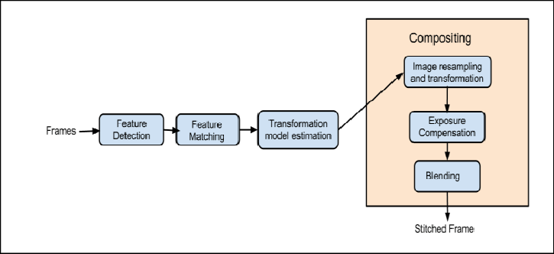
Recall: Global flow for panorama stitching

Slide 3
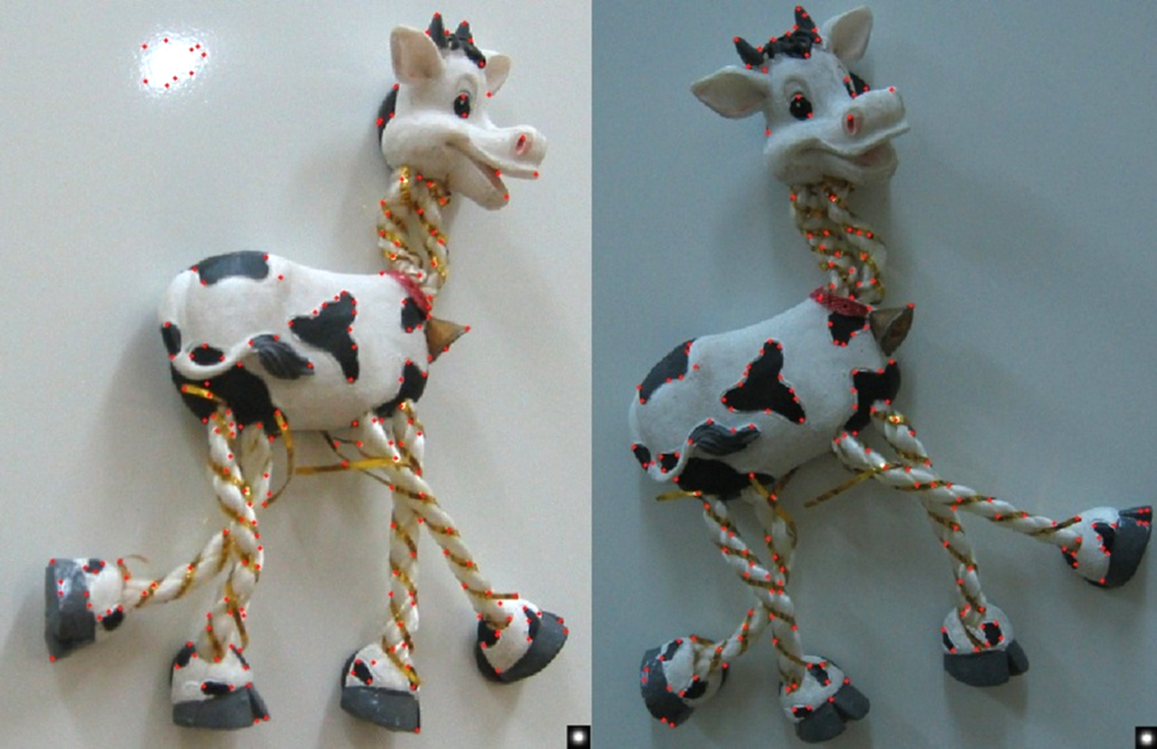
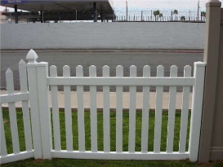
Previous class
Interest point/keypoint/feature detectors
Harris: detects corners
Feature matching
Ratio distance = ||f₁ - f₂ || / || f₁ - f₂’ ||
Remove 90% false matches, 5% of true matches in Lowe’s study
f₁
f₂'
f₂
I₁
I₂

Slide 4
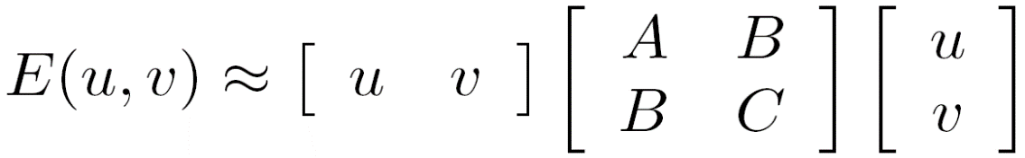
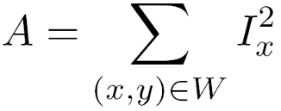
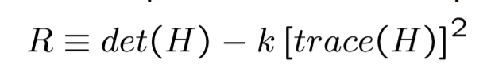
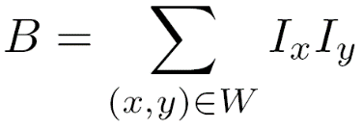

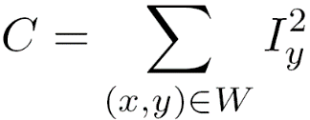
Recall: The Harris operator
The det is the determinant, i.e. det(H)=AC-B²
The trace is the sum of the diagonals, i.e., trace(H) = A+C
R called the “Harris Corner Detector” or “Harris Operator”
Lots of other detectors, this is one of the most popular
k - Harris detector free parameter in the equation (usually ~ 0.04-0.06)

Slide 5

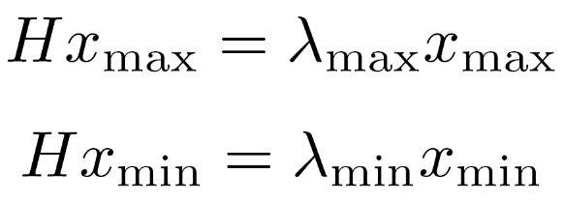
Another approach to Harris
x_{min}
x_{max}
Eigenvalues and eigenvectors of H
Define shift directions with the smallest and largest change in error
x_{max} = direction of largest increase in E
λ_{max} = amount of increase in direction x_{max}
x_{min} = direction of smallest increase in E
λ_{min} = amount of increase in direction x_{min}

Slide 6
Interpreting the eigenvalues
λ₂
“Edge” λ₂ >> λ₁
“Corner” λ₁ and λ₂ are large, λ₁ ~ λ₂; E increases in all directions
Classification of image points using eigenvalues of H:
λ₁ and λ₂ are small; E is almost constant in all directions
“Flat” region
“Edge” λ₁ >> λ₂
λ₁

Slide 7
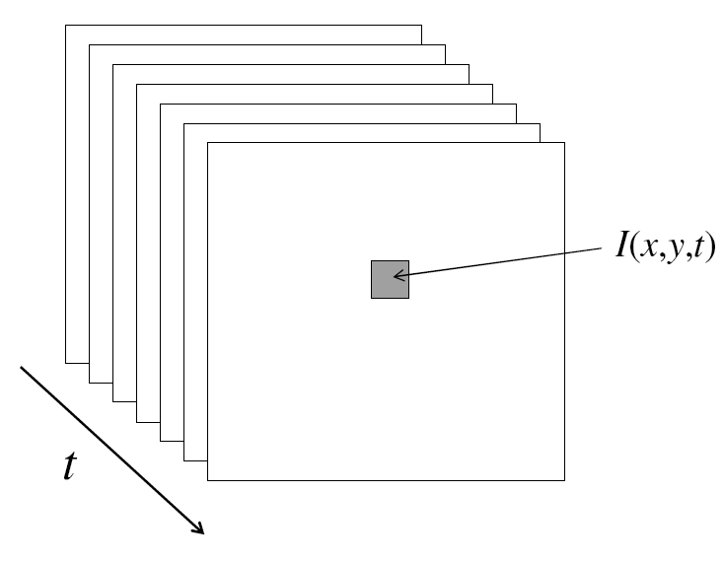
From images to videos
A video is a sequence of frames captured over time
Now our image data is a function of space (x, y) and time (t)

Slide 8
Feature tracking - Challenges
Figure out which features can be tracked
Efficiently track across frames
Some points may change appearance over time (e.g., due to rotation, moving into shadows, etc.)
Drift: small errors can accumulate as appearance model is updated
Points may appear or disappear: need to be able to add/delete tracked points

Slide 9
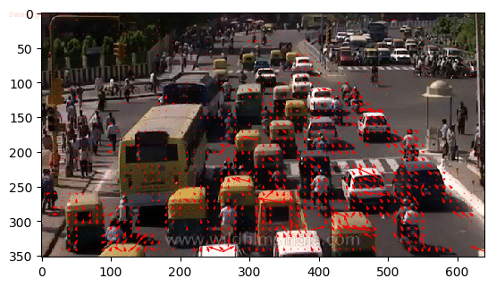
Optical flow
In video we do need the relationships between consecutive frames, for example, we want to track the motion of vehicles across frames to estimate its current velocity and predict its position in the next frame.

Slide 10
Estimate optical flow
I(x,y,t)
I(x,y,t+1)
Given two subsequent frames, estimate the point translation
Key assumptions of Lucas-Kanade Tracker
Brightness constancy: projection of the same point looks the same in every frame
Small motion: points do not move very far
Spatial coherence: points move like their neighbors

Slide 11
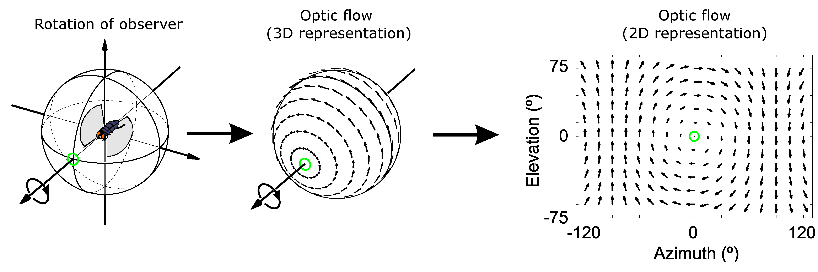
Optical flow
Definition: optical flow is the apparent motion of brightness patterns in the image
Note: apparent motion can be caused by lighting changes without any actual motion
Think of a uniform rotating sphere under fixed lighting vs. a stationary sphere under moving illumination
Source: Silvio Savarese
GOAL: Recover image motion at each pixel from optical flow

Slide 12
Sparse vs Dense Optical Flow
Sparse optical flow gives the flow vectors of some "interesting features" (say few pixels depicting the edges or corners of an object) within the frame, while
Dense optical flow, which gives the flow vectors of the entire frame (all pixels) - up to one flow vector per pixel. As you would've guessed, Dense optical flow has higher accuracy at the cost of being slow/computationally expensive.

Slide 13
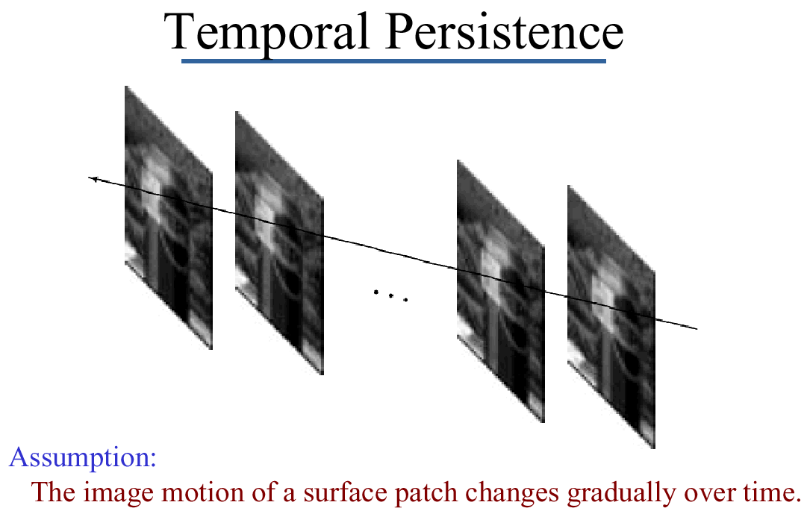
Key Assumptions: small motions
* Slide from Michael Black, CS143 2003

Slide 14
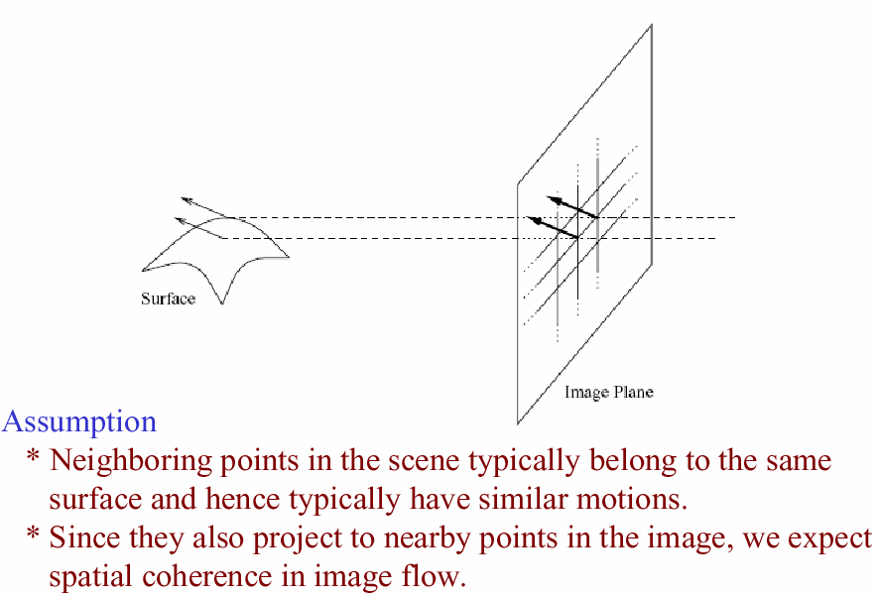
Key Assumptions: spatial coherence
* Slide from Michael Black, CS143 2003

Slide 15
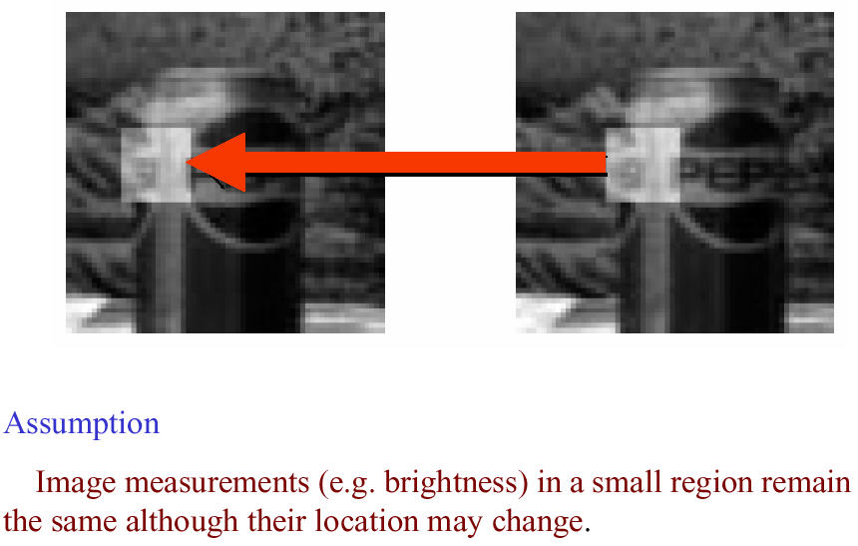
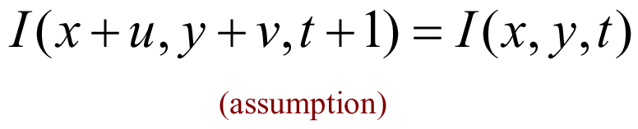
Key Assumptions: brightness Constancy
$$I\left(x,y,t\right)=I(x+u\left(x,y\right), y+v\left(x,y\right), t+1)$$
* Slide from Michael Black, CS143 2003

Slide 16
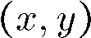
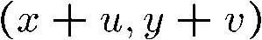
The brightness constancy constraint
I(x,y,t)
I(x,y,t+1)
Brightness Constancy Equation:
Take Taylor expansion of I(x+u, y+v, t+1) at (x,y,t) to linearize the right side:
Image derivative along x
Difference over frames
So:
Notes:
Brightness constancy equation is equivalent to minimizing the squared error of I(t) and I(t+1)

Slide 17
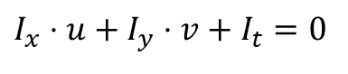
The brightness constancy constraint
Can we use this equation to recover image motion (u,v) at each pixel?
$$I_{x}⋅u+I_{y}⋅v+I_{t}=0$$
How many equations and unknowns per pixel?
One equation (this is a scalar equation!), two unknowns (u,v)
The component of the motion perpendicular to the gradient (i.e., parallel to the edge) cannot be measured
gradient
(u,v)
If (u, v) satisfies the equation, so does (u+u’, v+v’ ) if
(u+u’,v+v’)
(u’,v’)
edge
Notes:
Suppose (u,v) satisfies the equation,
now let's add a u',v' component
since u',v' is perpendicular to the gradient, the dot product of u'v' is zero!
then u+u', v+v' also satisfies the equation.

Slide 18
The aperture problem
Actual motion

Slide 19
The aperture problem
Perceived motion

Slide 20

The barber pole illusion
http://en.wikipedia.org/wiki/Barberpole_illusion

Slide 21


The barber pole illusion
http://en.wikipedia.org/wiki/Barberpole_illusion

Slide 22
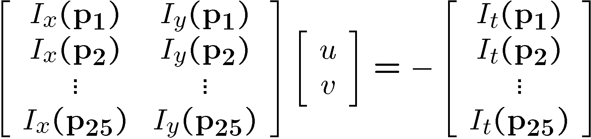
Solving the ambiguity…
B. Lucas In Proceedings of the International Joint Conference on Artificial Intelligence, pp. 674–679, 1981.
s and T. Kanade. An iterative image registration technique with an application to stereo vision.
How to get more equations for a pixel?
Spatial coherence constraint
Assume the pixel’s neighbors have the same (u,v)
If we use a 5x5 window, that gives us 25 equations per pixel

Slide 23




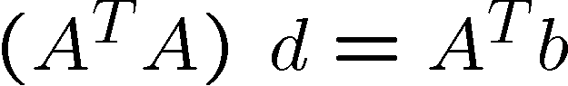
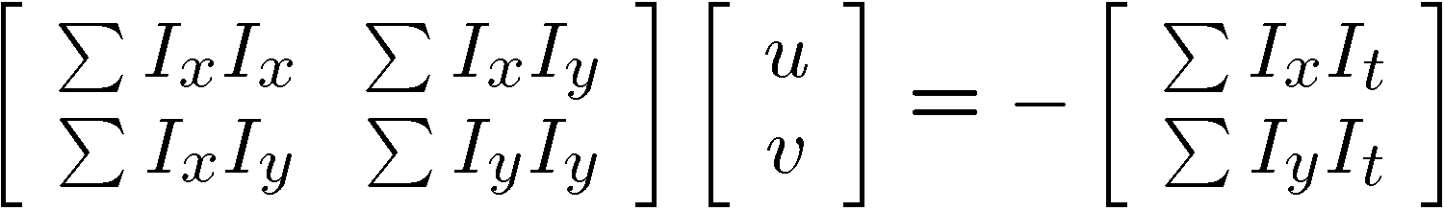
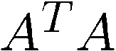
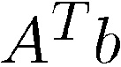
Matching patches across images
Overconstrained linear system
Least squares solution for d given by
The summations are over all pixels in the K x K window

Slide 24
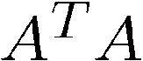
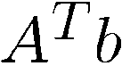
Conditions for solvability
Optimal (u, v) satisfies Lucas-Kanade equation
When is this solvable? I.e., what are good points to track?
A^{T}A should be invertible
A^{T}A should not be too small due to noise
eigenvalues λ₁ and λ ₂ of A^{T}A should not be too small
A^{T}A should be well-conditioned
λ ₁/ λ ₂ should not be too large (λ ₁ = larger eigenvalue)
Does this remind you of anything?
Criteria for Harris corner detector

Slide 25
Interpreting the eigenvalues
λ₂
“Edge” λ₂ >> λ₁
Classification of image points using eigenvalues
“Corner” λ₁ and λ₂ are large, λ₁ ~ λ₂; E increases in all directions
λ₁ and λ₂ are small; E is almost constant in all directions
“Flat” region
“Edge” λ₁ >> λ₂
λ₁

Slide 26
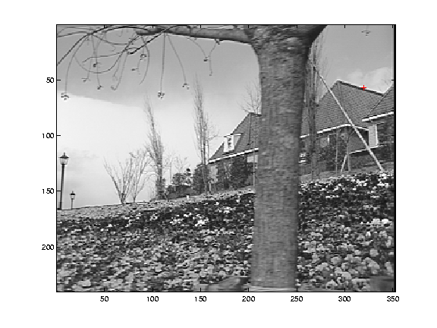
Low-texture region
gradients have small magnitude
small λ₁, small λ₂
A^{T}A

Slide 27
Edge
A^{T}A
gradients very large or very small
large λ₁, small λ₂

Slide 28
High-texture region
gradients are different, large magnitudes
large λ₁, large λ₂
A^{T}A

Slide 29
The aperture problem resolved
Actual motion

Slide 30
The aperture problem resolved
Perceived motion

Slide 31
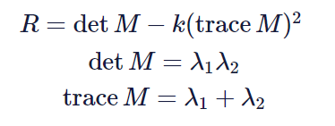
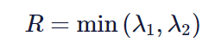
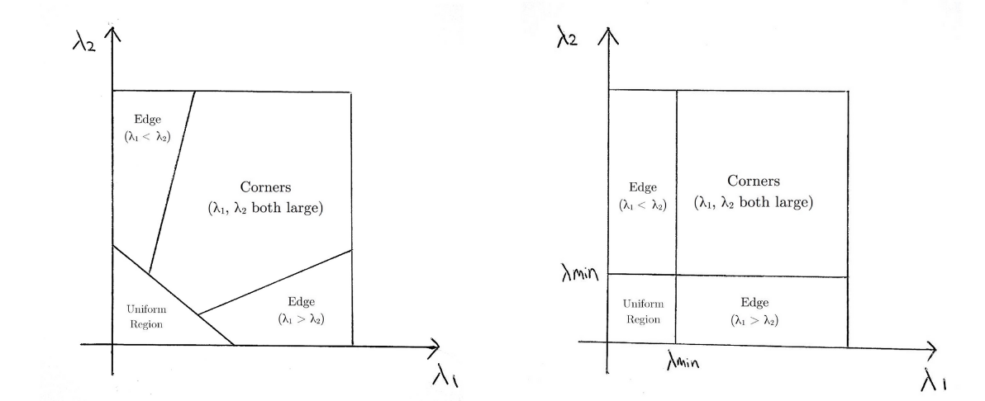
Modification to Harris to find features: Shi-Tomasi Corner Detector
The modification is to the equation in which score R is calculated. In the Harris Corner Detector, the scoring function is given by:
Instead, Shi-Tomasi proposed the scoring function as:
The following compares the scoring functions of Harris (left) and Shi-Tomasi (right)

Slide 32
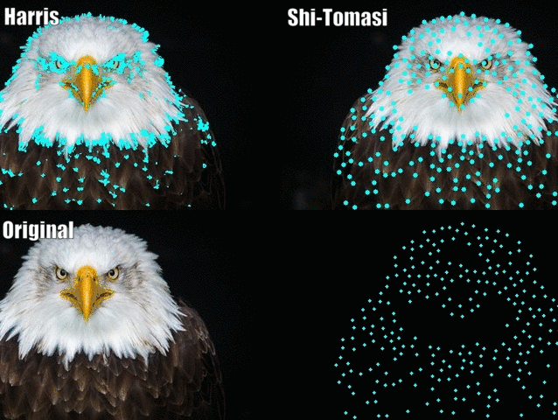

Slide 33
Iterative refinement
Original (x,y) position
I_{t} = I(x’, y’, t+1) - I(x, y, t)
Initialize (x’,y’) = (x,y)
Compute (u,v) by
Shift window by (u, v): x’=x’+u; y’=y’+v;
Recalculate I_{t}
Repeat steps 2-4 until small change
Use interpolation for subpixel values
2nd moment matrix for feature patch in first image
displacement

Slide 34
Errors in Lukas-Kanade
What are the potential causes of errors in this procedure?
Assumed A^{T}A is easily invertible
Assumed there is not much noise in the image
When our assumptions are violated
Brightness constancy is not satisfied – Possible Fix: Gradient constancy
The motion is not small – Possible Fix: Coarse to fine approach
A point does not move like its neighbors - Possible Fix: Region-based matching
window size is too large
what is the ideal window size?
* From Khurram Hassan-Shafique CAP5415 Computer Vision 2003

Slide 35
Recap
Key assumptions (Errors in Lucas-Kanade)
Small motion: points do not move very far
Brightness constancy: projection of the same point looks the same in every frame
Spatial coherence: points move like their neighbors
Source: Silvio Savarese

Slide 36
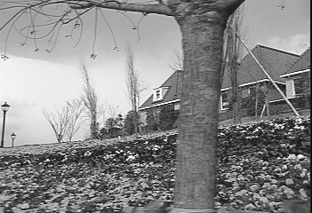
Revisiting the small motion assumption
* From Khurram Hassan-Shafique CAP5415 Computer Vision 2003
Is this motion small enough?
Probably not—it’s much larger than one pixel
How might we solve this problem?

Slide 37
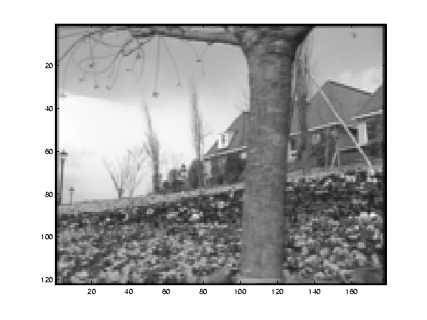
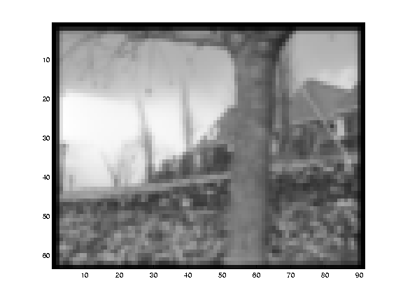
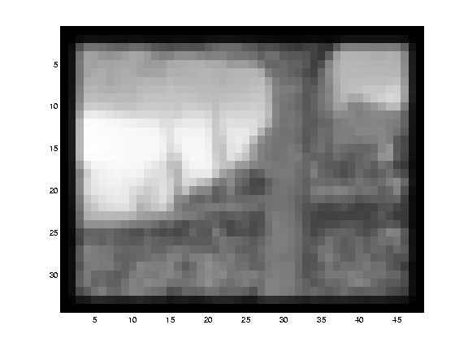
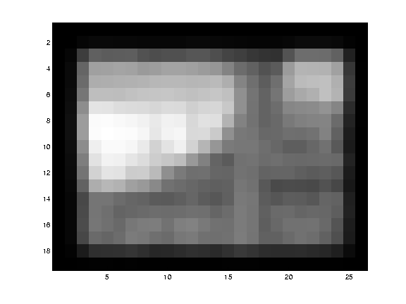
Reduce the resolution!
* From Khurram Hassan-Shafique CAP5415 Computer Vision 2003

Slide 38
Coarse-to-fine optical flow estimation
u=1.25 pixels
u=2.5 pixels
u=5 pixels
image H
u=10 pixels
image I
image 1
image 2
Source: Silvio Savarese
Gaussian pyramid of image 1
Gaussian pyramid of image 2

Slide 39
Applications

Slide 40
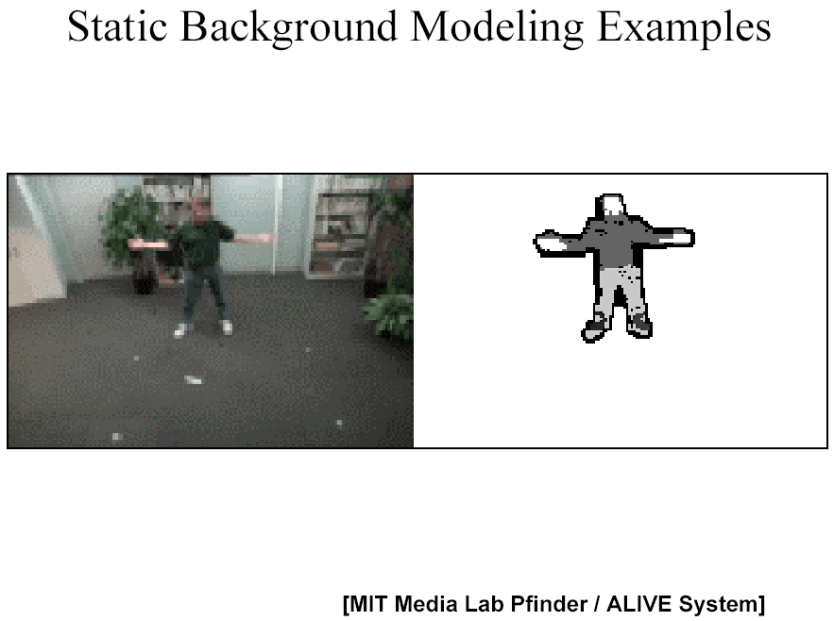
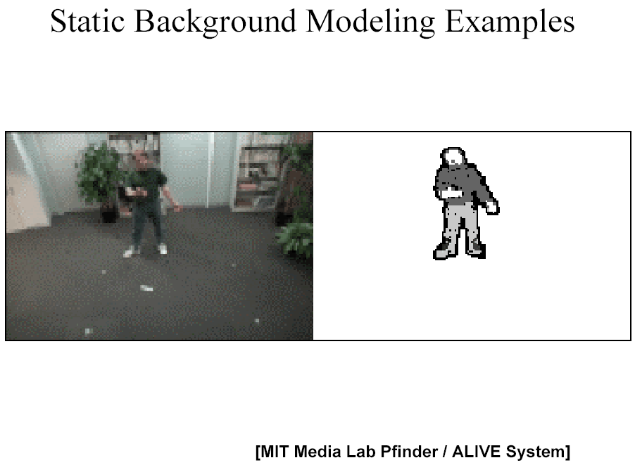
Segmenting objects based on motion cues
Background subtraction
A static camera is observing a scene
Goal: separate the static background from the moving foreground
Source: Silvio Savarese

Slide 41
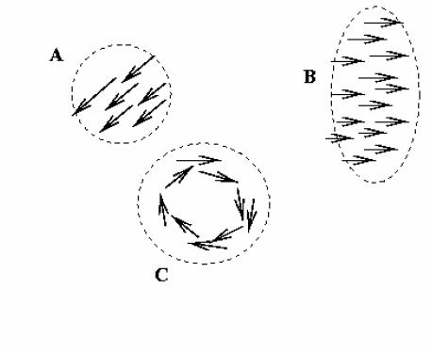
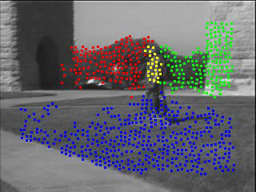
Segmenting objects based on motion cues
Motion segmentation
Segment the video into multiple coherently moving objects
Source: Silvio Savarese
S. J. Pundlik and S. T. Birchfield, Motion Segmentation at Any Speed, Proceedings of the British Machine Vision Conference (BMVC) 2006

Slide 42
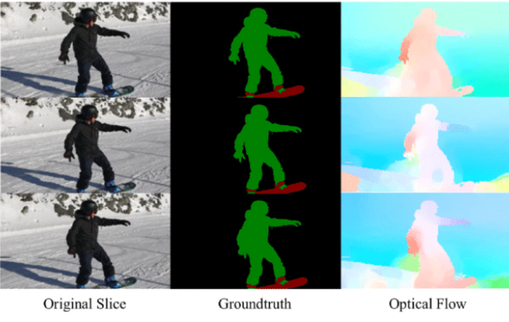
Optical Flow application: Semantic Segmentation
The task of semantic segmentation is to divide an image into series of regions corresponding to unique object classes (yet closely placed objects with identical textures are often difficult for single frame segmentation techniques). If the objects are placed separately, however, the distinct motions of the objects may be highly helpful where discontinuity in the optical flow field correspond to boundaries between objects.

Slide 43
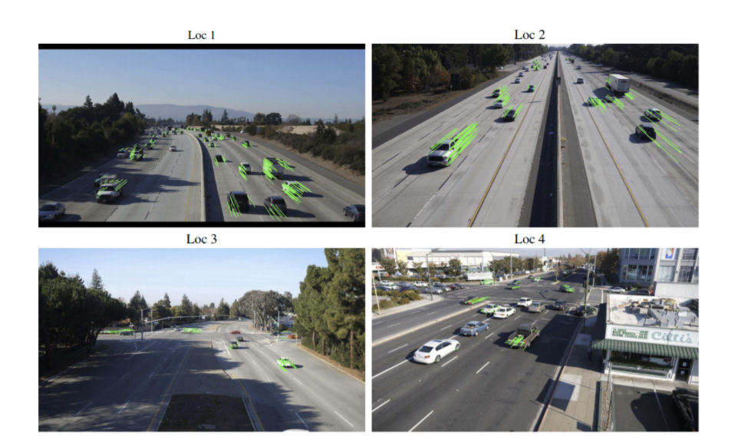
Optical Flow application: Object Detection & Tracking
Since sparse optical flow utilizes tracking of points of interest, such real-time systems may be performed by feature-based optical flow techniques from either from a stationary camera or cameras attached to vehicles.

Slide 44
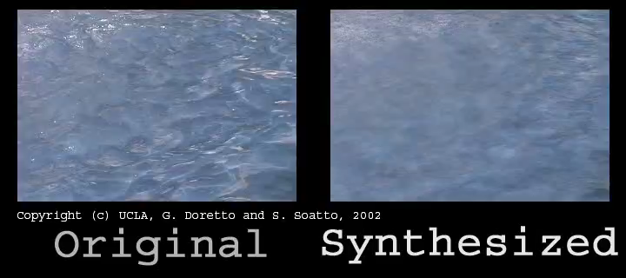
Synthesizing dynamic textures

Slide 45
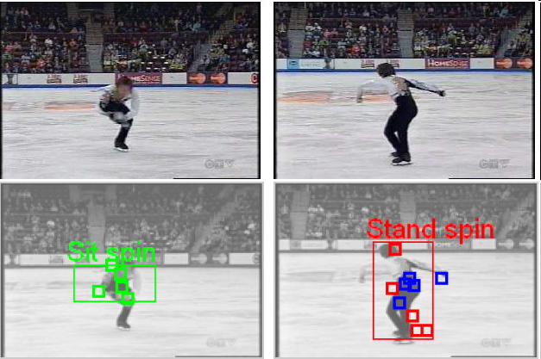
Recognizing events and activities
Juan Carlos Niebles, Hongcheng Wang and Li Fei-Fei, Unsupervised Learning of Human Action Categories Using Spatial-Temporal Words, (BMVC), Edinburgh, 2006.

Slide 46
What we have learned today
Estimating motion using optical flow
Lucas-Kanade method
Another feature detection: Shi-Tomasi Corner Detector
Pyramids for large motion
Applications

Slide 47
Thank you!

